Slide 1
The Impact of Globalization on Economic Growth
Presented by: Abdul Rehman Shoukat

Slide 2
Data
Panel Data Analysis
Developed and Developing Countries
Time Dimension (1970-2018)
Data Sources:
World Bank
United Nations Conference on Trade and Development (UNCOTD)
WDI

Slide 3

Variables and Theoretical Framework
$Y_{it}$ = $β_{0}$ + $β_{1}{Glob}_{it}$ + $β_{2}{Infl}_{it}+$ $β_{3}{GFCF}_{it}$ + $β_{4}{Govsp}_{it}+$ $β_{5}{HDI}_{it}$ + $β_{6}{Exp}_{it}+$ $β_{7}{Imp}_{it}$ + $β_{8}{FDI}_{it}+$ $β_{9}{Popgr}_{it}$ + $β_{10}{EX}_{it}$ + $μ$
Variables | Description | Measurement | Data Source
Glob | Globalization | Measured by KOF Globalization Index | World Bank
Infl | Inflation | Percentage Change in price levels | World Bank
GFCF | Gross Fixed Capital Formation | Measures the net increase in fixed capital | United Nations Conference on Trade and Development
Govsp | Government Spending | Money spent by the government | World Bank

Slide 4
Variables and Theoretical Framework
Variables | Description | Measurement | Data Sources
HDI | Human Development Index | Measures 3 key dimensions of human development; life expectancy, years of education and standard of Living | WDI
Exp | Export | Value of all goods and other market services provided to the rest of the world. | World Bank
Imp | Import | Value of all goods and other market services received from the rest of the world | World Bank
FDI | Foreign Direct Investment | Foreign Direct Investment (FDI) stocks measure the total level of direct investment at a given point in time | WDI
Popgr | Population growth | Annual Percentage Increase | World Bank
EX | Exchange Rate | Rate at which one currency can be exchanged for another between nations or economic zones | WDI

Slide 5
Variables Dependent (Main)
Economic Growth (GDP)
"Economic growth is a quantitative phenomenon that actually shows the increase of value of goods and services produced in an economy and are usually measured as a percentage of increase in GDP”,
Expected Sign (Majidi,2017)
Upper middle income
Political = (-)
Social = (-)
Economic = (-)
Lower middle income
Political = (+)
Social = (-)
Economic = (-)

Slide 6
Variables Independent (Major)
Globalization
the process by which businesses or other organizations develop international influence or start operating on an international scale, using the KOF index of Globalization covering Economic, Social and Political Integration.
Expected Sign (-), (Suci et al., 2016)

Slide 7
Variables Independent (Minor)
Inflation
" Inflation as measured by the consumer price index reflects the annual percentage change in the cost to the average consumer of acquiring a basket of goods and services”
Expected Sign (-), (Majidi,2017)
Gross Fixed Capital Formation
the total spending on fixed investment (plant, equipment, etc.) in an economy over a one-year period. Gross domestic fixed-capital formation is one component of GNP
Expected Sign (+), (Majidi,2017)

Slide 8
Variables Independent (Minor)
Government Spending
Expenditure refers to the money spent by the public sector on the provision of services such as education, social protection, healthcare, and defense, along with the acquisition of goods.
Expected Sign (+), (Suci et al., 2016)
Human Development Index
The Human Development Index (HDI) is a measure of average achievement in key dimensions of human development: a long and healthy life, being knowledgeable and having a decent standard of living.
Expected Sign (-), (Suci et al., 2016)

Slide 9
Variables Independent (Minor)
Trade Openness
Export
value of all goods and other market services provided to the rest of the world
Expected Sign (+), (Ullah et al.,2017)
Import
value of all goods and other market services received from the rest of the world
Expected Sign (+), (Ray,2012)

Slide 10
Variables Independent (Minor)
Foreign Direct Investment
Foreign direct investment (FDI) is an ownership stake in a foreign company or project made by an investor, company, or government from another country. Foreign Direct Investment (FDI) stocks measure the total level of direct investment at a given point in time
Expected Sign (+), (Blomström et al., 1992)
Population Growth
Population Growth is defined as the increase in the number of individuals in a population, measured by Natural population growth, Population growth rate
Expected Sign (-), (Maqbool et al., 2017)

Slide 11
Variables Independent (Minor)
Exchange Rate
An exchange rate is a rate at which one currency will be exchanged for another currency, U.S dollar as an indicator of international transaction exchange prices
Expected Sign (+), (Alimi et al .,2011)

Slide 12
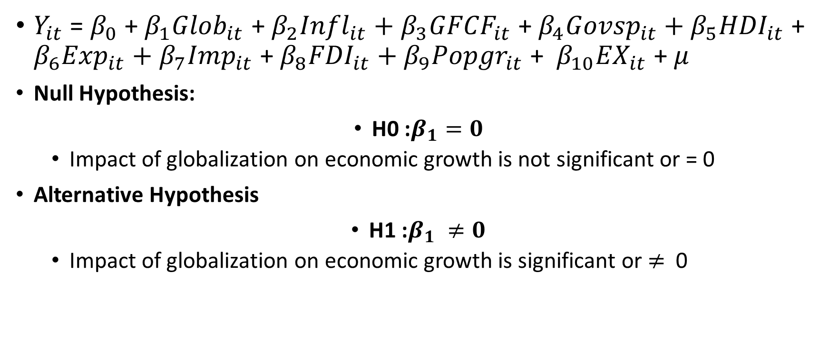
Hypothesis
$Y_{it}$ = $β_{0}$ + $β_{1}{Glob}_{it}$ + $β_{2}{Infl}_{it}+$ $β_{3}{GFCF}_{it}$ + $β_{4}{Govsp}_{it}+$ $β_{5}{HDI}_{it}$ + $β_{6}{Exp}_{it}+$ $β_{7}{Imp}_{it}$ + $β_{8}{FDI}_{it}+$ $β_{9}{Popgr}_{it}$ + $β_{10}{EX}_{it}$ + $μ$
Null Hypothesis:
H0 :$β_{1}=0$
Impact of globalization on economic growth is not significant or = 0
Alternative Hypothesis
H1 :$β_{1} ≠0$
Impact of globalization on economic growth is significant or $≠$ 0

Slide 13
References
Majidi, A. F. (2017). Globalization and economic growth: The case study of developing countries. Asian Economic and Financial Review, 7(6), 589-599.
Gurgul, H., & Lach, Ł. (2014). Globalization and economic growth: Evidence from two decades of transition in CEE. Economic Modelling, 36, 99-107.
Suci, S. C., Asmara, A., & Mulatsih, S. (2016). The impact of globalization on economic growth in ASEAN. BISNIS & BIROKRASI: Jurnal Ilmu Administrasi dan Organisasi, 22(2), 79-87.
Ullah, F., Rauf, A., & Rasool, N. (2013). Analyzing the Impact of Globalization on Economic Growth. Acta Universitatis Danubius. Œconomica, 10(2).
Ray, S. (2012). Globalization and economic growth in India: A Granger causality approach. JL Pol'y & Globalization, 2, 18.
Blomström, Magnus; Robert E. Lipsey; Mario Zejan (1992), What Explains Developing Country Growth?, NBER Working Paper 4132.
Maqbool-ur-Rahman, M. (2015). Impacts of globalization on economic growth-evidence from selected South Asian countries. Journal of Management Sciences, 2(1), 185-204.
Alimi, O. Y., & Atanda, A. A. (2011). Globalization, business cycle and economic growth in Nigeria. African Journal of Scientific Research, 7(1).

Slide 14
Thank You!

